Slide 1
DETERMINING THE PLACES FOR ACCOMODATION IN MUMBAI
Rohan Shukla
As a part of Applied Data Science Capstone-IBM

Slide 2
Introduction
Mumbai is one of the most vibrant cities of India. As of 2018, Mumbai was the most populous city of India.
With around twenty million population, everything gets crowded
Need for living peacefully and being able to obtain a liveable and healthy environment becomes one of the major priorities when searching for a proper neighbourhood to live in.

Slide 3
Target Audience
The target audience for this analysis are those who are looking for houses in various neighbourhoods, and want to know the areas which are popular in the neighbourhoods.
People could also use this to set or estimate the prices according to the luxuries and necessities present in the neighbourhood.

Slide 4
Database Used
https://en.wikipedia.org/wiki/List_of_neighbourhoods_in_Mumbai
Feature selection was done by converting the popular areas around a neighbourhood in a 500m radius through one-hot encoding. Then the top ten locations were selected for each borough and used as the features for clustering.
The data was cleaned and preprocessed. All the boroughs were combined. The neighbourhoods were combined, and listed as a single comma separated attribute.

Slide 5
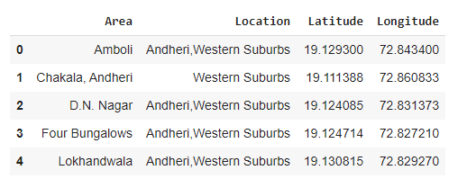
Data Analysis
The initial dataset did not have the necessary data to extract the characteristics of each borough from the four square API. Hence, the data set was modified and shortened.

Slide 6
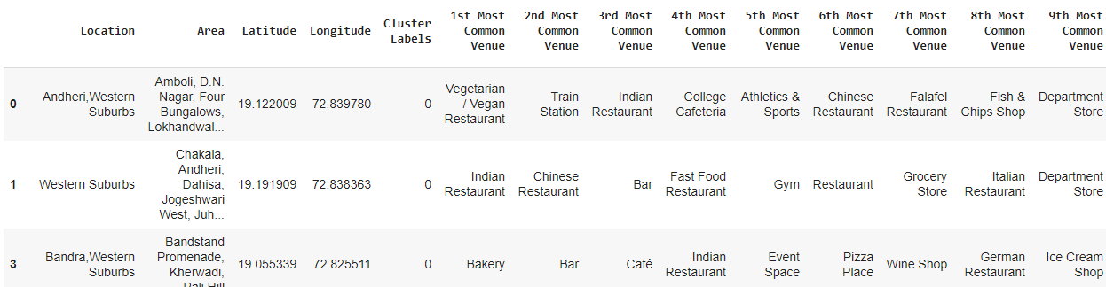
Data Transformation
The data from the Four Square API is collected and transformed such that the top ten visited places for the area are its attributes for the predictive analysis.

Slide 7
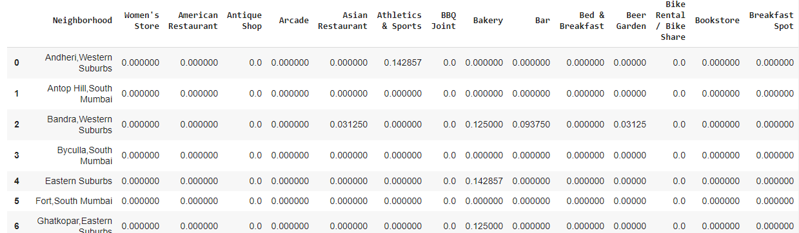
This data is prepared by using the ONE-HOT encoding technique. The list of all the neighbourhoods and the frequency of visits to the places in the area were obtained and the mean was taken. This was converted to the data-frame.

Slide 8
Outliers
Along with the above analysis, there were six neighbourhoods identified in which there were no significant venues to be considered among the top ten places. Hence, those areas or boroughs were considered as outliers and not included in the analysis

Slide 9
Clustering
K-Means Clustering was used to classify the areas as ones to live or buy a house and those to avoid.
Since the city is developed, the clustering techniques yielded those selected areas where one should prefer to not buy the house.

Slide 10
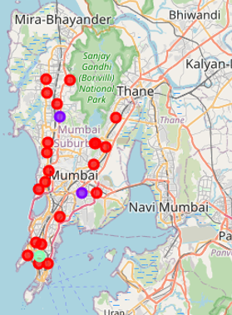
Plotting the clusters on the Map

Slide 11
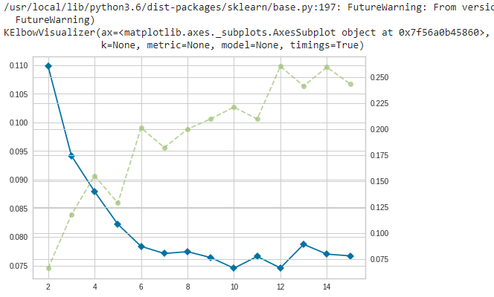
Analysis
The K-Means Clustering algorithm implemented was tested at various levels of K and the elbow plot with the ‘silhouette’ metric was created. Optimal value at K=3

Slide 12
Conclusion
To conclude our analysis, we can identify the neighbourhoods in which one should opt to live and one should not opt to live in Mumbai.
Cluster 1: It shows the areas where people opt to live. It consists of 25 areas, consisting of multiple neighbourhoods. We could observe the existence of departmental stores, convenience stores, women's store, gym, stations, grocery stores along with the restaurants and cafes.
Cluster 2, 3 and other 6 Neighbourhoods: These localities are mainly commercial and entertainment areas. It would not be ideal for one to live in such areas. These areas are mostly the ones consisting of restaurants, bars, flea market, smoking and bbq joints as well as offices and commercial buildings.
Using K-Means clustering algorithm was beneficial for the unsupervised data where one could cluster the localities into those ideal for living and those which are not.

Slide 13
Further Scope
One can back these results by combining it with the average price of the household prevailing in this area.
Also, population density at night and daytime can be compared. These analysis would further extrapolate the accuracy of the analysis and back it up with statistical significance.

Slide 14
THANK YOU

